Slide 1
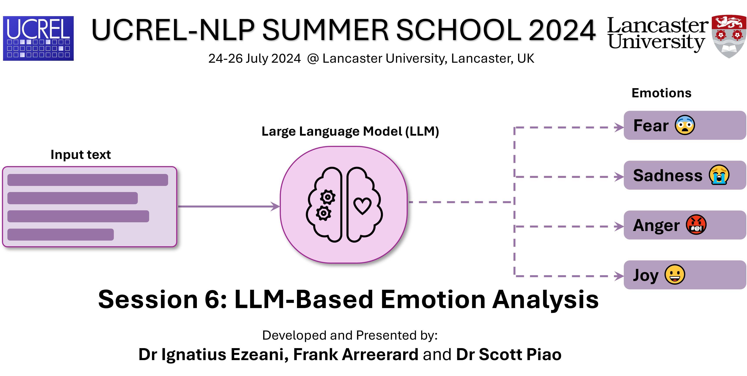

Slide 2
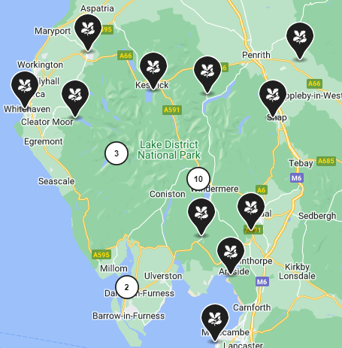
Motivation
Textual geographies focus on geoparsing
identifying place names and allocating coordinates to them.
Limited to places with coordinates; little to no concept of time.
It often misses
the vague, imprecise, and ambiguous e.g. “the camp”, or “the hills in the distance”, and
relative locations such as “near to”, “on the left”, “north of” or “a few hours’ journey from”.
This project explores ways to
identify, extract, visualize, and analyze qualitative and quantitative references to place and time…
…and events, experiences, emotions, and memories accompanying the geography.
Notes:
We aim to gain more insight from textual data beyond the toponyms and introduce an extensible framework for extracting, analyzing, and visualizing spatial elements

Slide 3
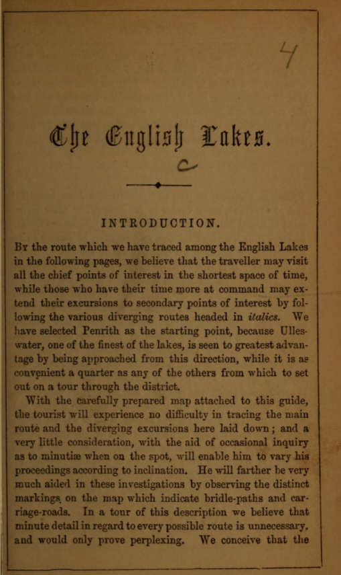



Corpus of Lake District Writing
Comprises 80 texts and around 1.5 million
Texts created between 1622 – 1900
Containing travel literature, fiction, histories, letters, and diaries.
Includes works by well-known Lake Poets
e.g. William Wordsworth and Samuel Taylor Coleridge.
Also accounts by prominent writers such as Daniel Defoe and Celia Fiennes
The English Lakes
– by Thomas Nelson & Sons (1857)
CLDW: Lake District Corpus Repository (https://github.com/UCREL/LakeDistrictCorpus)

Slide 4

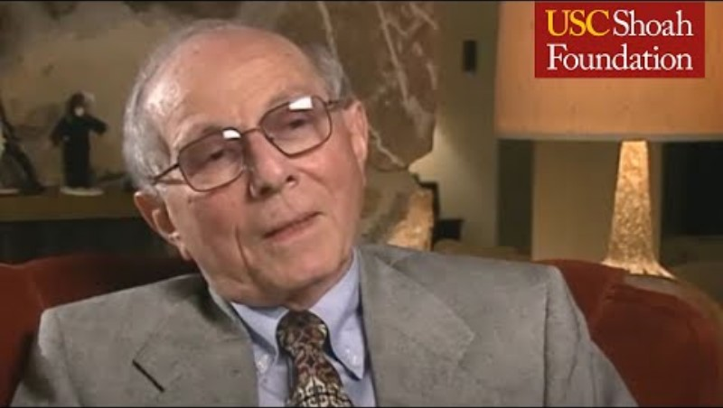
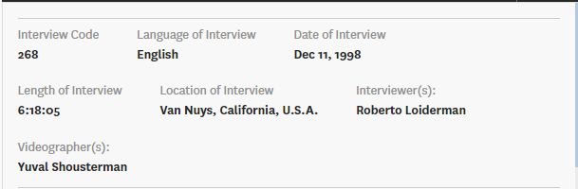
Holocaust Survivor’s Testimonies
≈1k (now 998) transcripts of survivor interviews, tokens
Each comprises a series of interviewer's questions and the survivor’s answers
Chronicles the survivor’s Holocaust experience
Duration ≈ 2hrs: 20% pre-war life; 60% wartime experience; 20% post-war
Highlights sites of incarceration or hiding serving as anchors that describe survivors’ wartime trajectories.
HST: Visual History Archive (https://vha.usc.edu/home)

Slide 5
Project Objective
Given a writing/transcript, we want to extract and possibly build a narrative around
Locations:
Names of places – cities, countries, camps – mentioned in the testimony. May be converted to coordinates for mapping e.g. Poland, Utrecht, Auschwitz-Birkenau
Locale:
events that occur at a place will contribute to this
various forms of date, time, and other temporal references
as well as spatial and geographical features, ‘camp’, ‘ghetto’, ‘gas chamber’, ‘school’, `train` etc. often vague or ambiguous and cannot be directly mapped in Euclidean space.
Sense of place:
subjective sentiments and emotional expressions by the survivor about a place

Slide 6
Project Objective
Given a writing/transcript, we want to extract and possibly build a narrative around
Locations:
Names of places – cities, countries, camps – mentioned in the testimony. May be converted to coordinates for mapping e.g. Poland, Utrecht, Auschwitz-Birkenau
Locale:
events that occur at a place will contribute to this
various forms of date, time, and other temporal references
as well as spatial and geographical features, ‘camp’, ‘ghetto’, ‘gas chamber’, ‘school’, `train` etc. often vague or ambiguous and cannot be directly mapped in Euclidean space.
Sense of place:
subjective sentiments and emotional expressions by the survivor about a place

Slide 7
Labelling Spatio-Temporal Entities
Names of places:
e.g. Poland:COUNTRY; Utrecht:CITY, Auschwitz-Birkenau:CAMP, Europe:CONTINENT
Spatial or geographical features:
GEONOUN – concentration camp, ghetto, factory, coal mine.
Temporal references:
October 7th, 1925: DATE; the summertime: DATE
about 6 o'clock in the morning-TIME; less than half an hour-TIME
Events:
EVENT – Hanukkah, World War II, Holocaust, Passover
Sentiments:
Uses a sentiment lexicon e.g. delightful:+EMOTION; pleasant:+EMOTION; horrible:-EMOTION

Slide 8
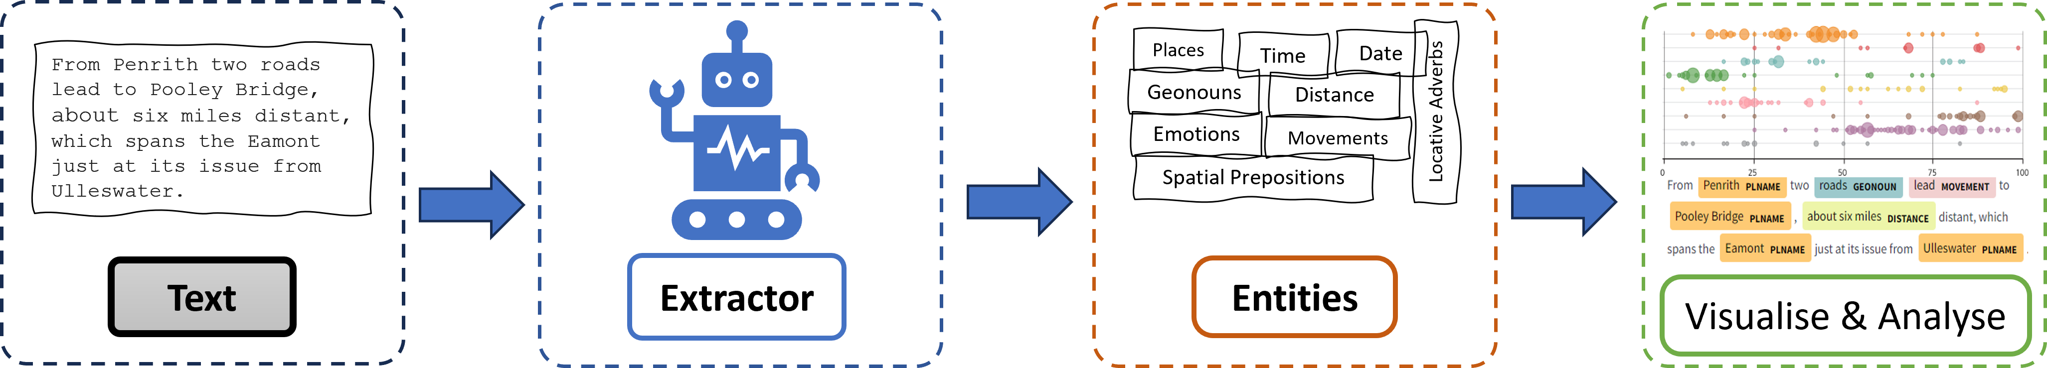
Annotation Framework

Slide 9
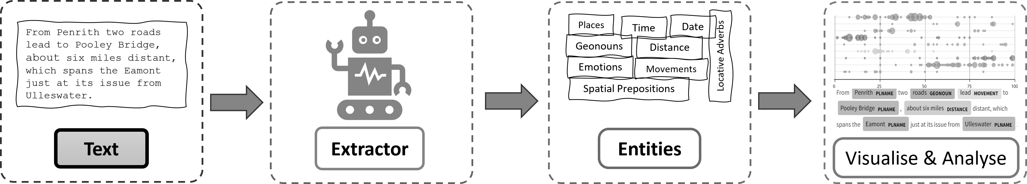
Annotation Framework

Slide 10




















Annotation Model and Pipeline
Dataset Creation
Model Training
Pre-processing + Correction
Evaluation
Re-training
lists of spatial entities
(toponyms, geo nouns, etc.)
Text Corpus
‘EntityRuler’
Pretrained Model
Training pipeline
From Penrith two roads lead to Pooley Bridge, about six miles distant, which spans the Eamont just at its issue from Ulleswater.
Extractor

Slide 11
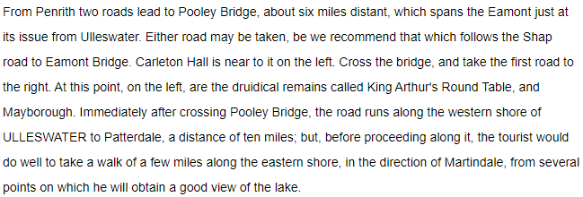
CLDW Example Text

Slide 12
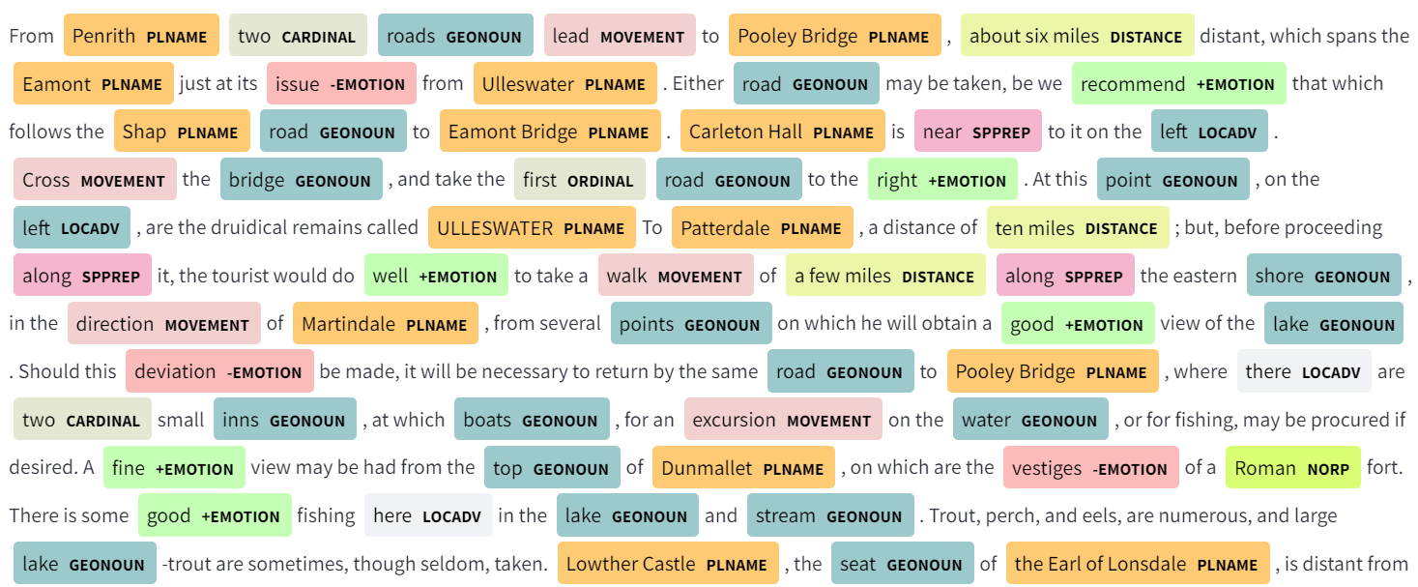
CLDW Example Text

Slide 13
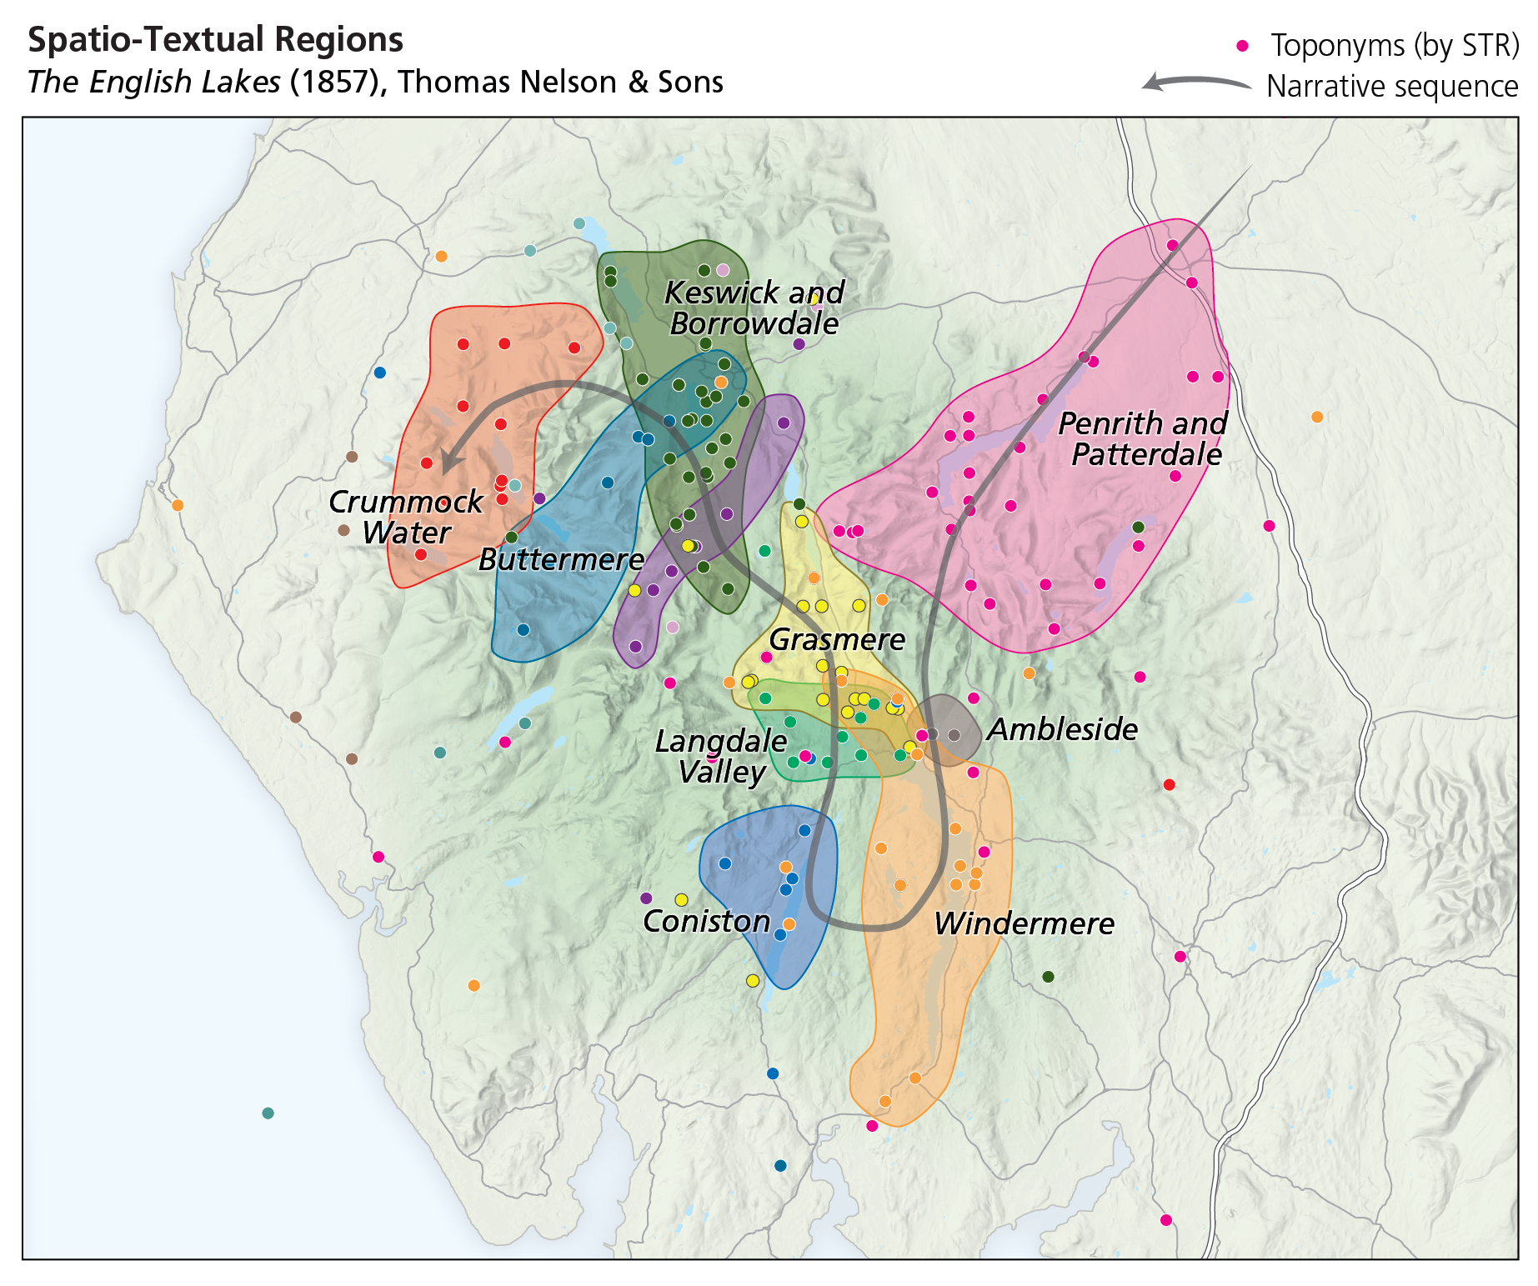
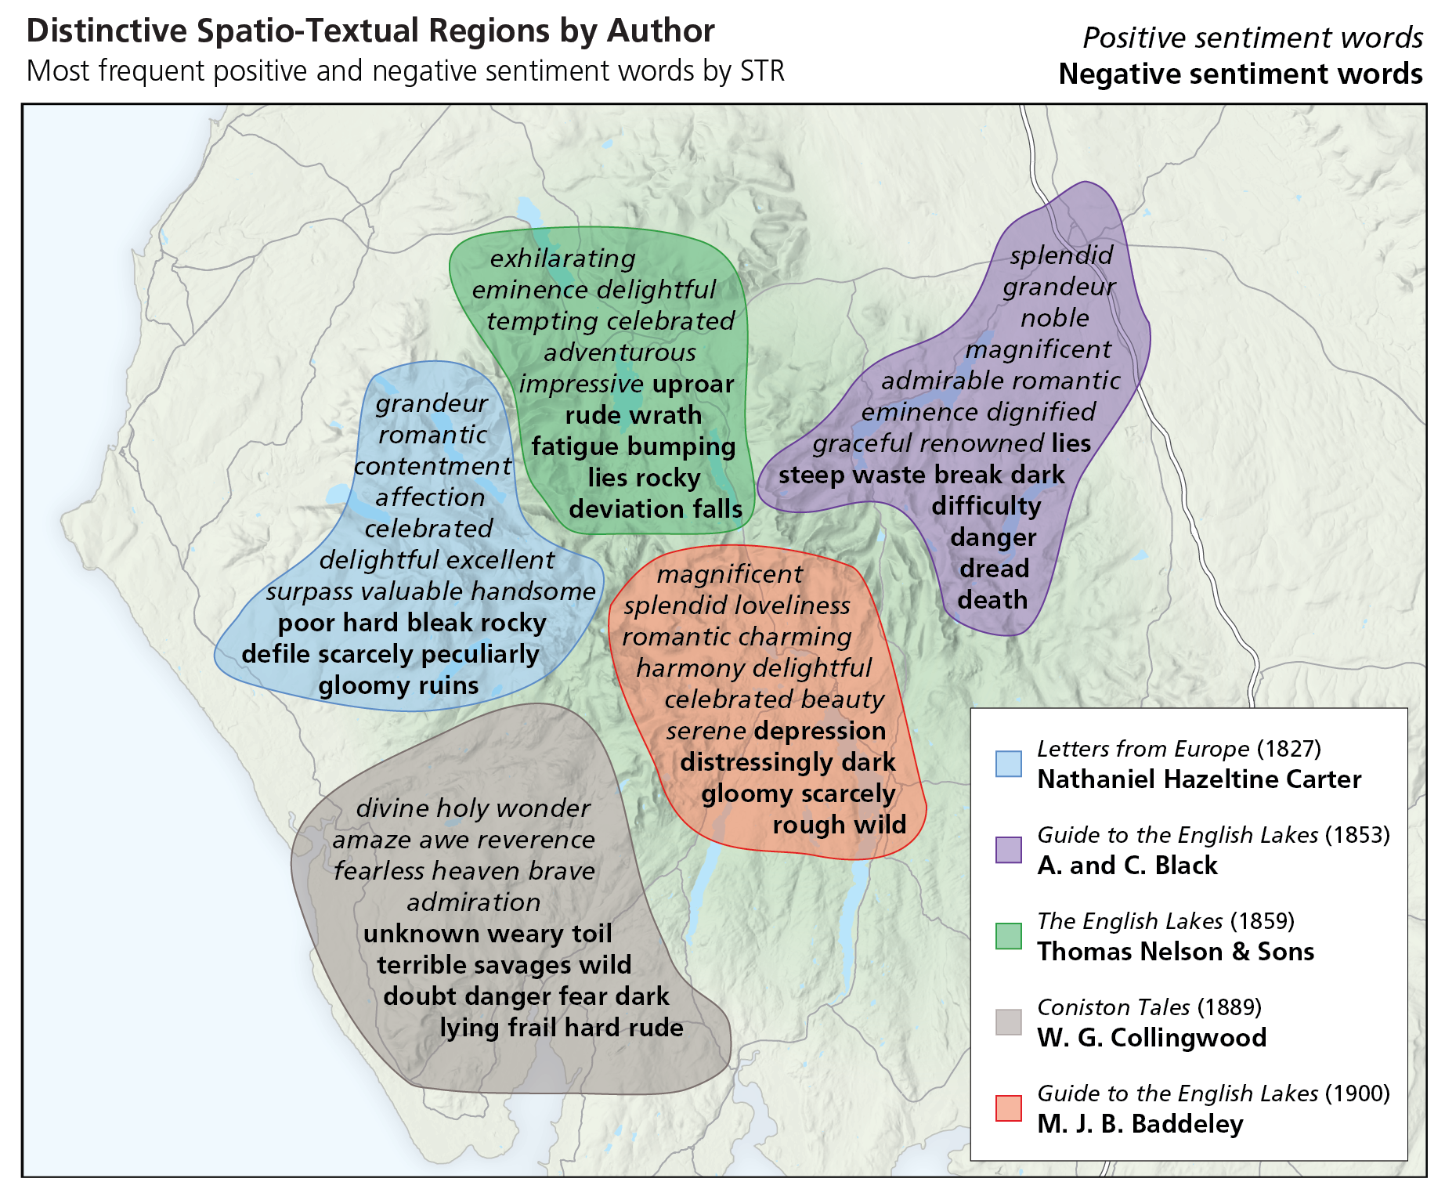
Previous work (CLDW)
CLDW: Narrative sequence, spatio-textual regions and sentiments
Source: Steiner, et al, Spatio-Textual Regions: Extracting Sense of Place from Spatial Narratives PLATIAL'23

Slide 14
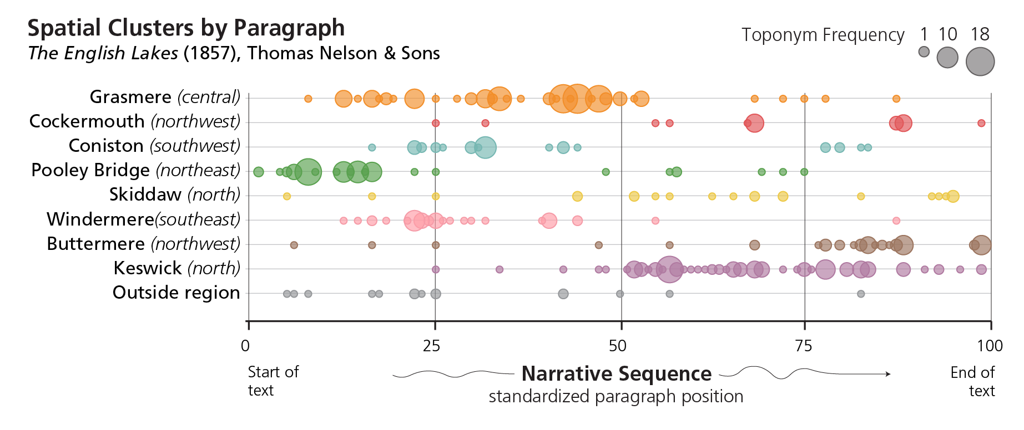
CLDW: Narrative sequence and regions
CLDW: Narrative sequence and spatio-textual regions
Source: Steiner, et al, Spatio-Textual Regions: Extracting Sense of Place from Spatial Narratives PLATIAL'23

Slide 15
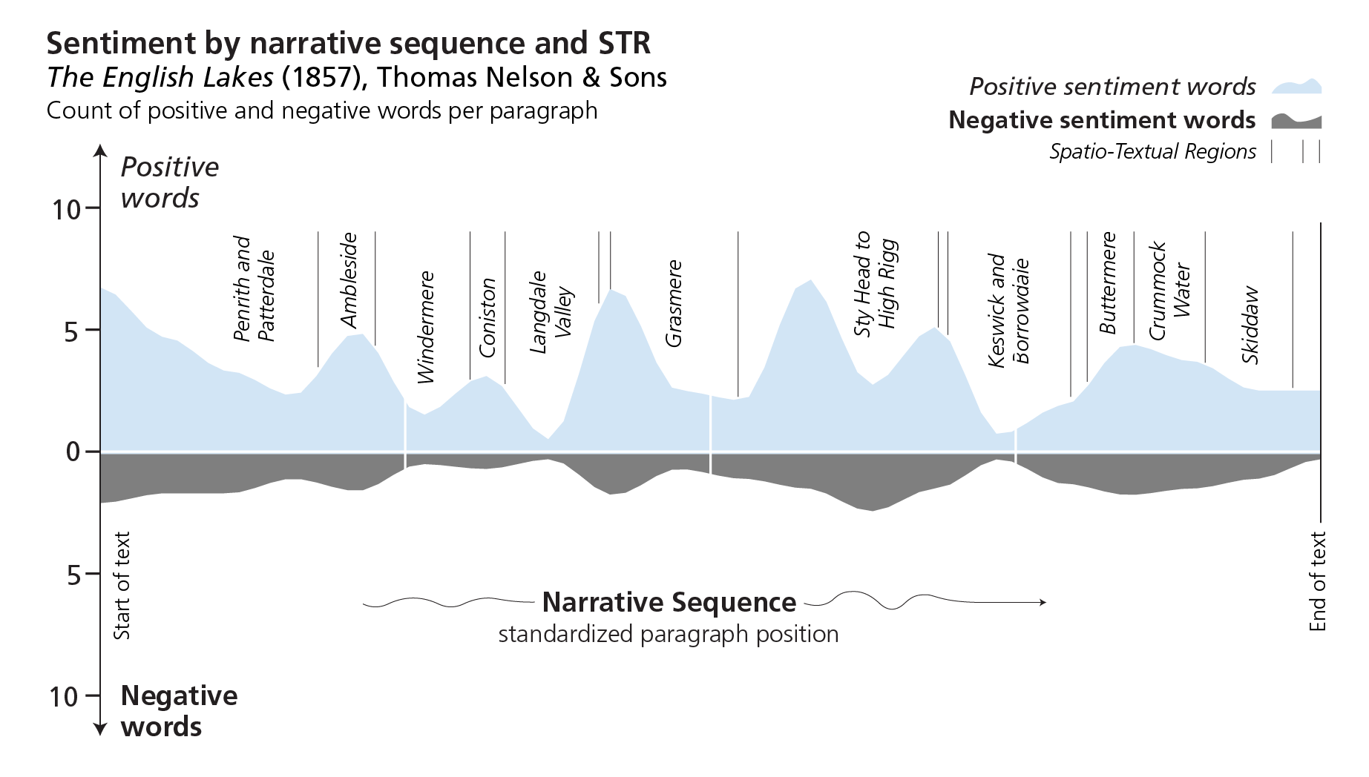
CLDW: Narrative sequence and sentiments
CLDW: Narrative sequence and sentiments
Source: Steiner, et al, Spatio-Textual Regions: Extracting Sense of Place from Spatial Narratives PLATIAL'23

Slide 16

But how was ‘fear’ 😨 expressed in HST? 🤔
'If they find me now, they sure will kill me.'
'And of course, I was terrified.',
"Don't shoot! Don't shoot!",
'And I said, please, can you help me?'
'Two or three shots rang out.'
"I knew that I couldn't last very much longer there.",
'And they would probably kill me.',
"I couldn't make it to the attic.",
'As we were marching forward the sounds came from behind us.',
"I said no, no, no, it's not me."
"If I go snitch on him, he says, they'll kill me."
"You're going to get us all killed, he said."
"I couldn't jump out the window."
GPT4 on testimony_id: 268

Slide 17
In this work…
We initially focussed on the emotion ‘fear’ in the HST.
But later considered ‘sadness’, ‘anger’, and ‘joy’.
How much ‘fear’ (or other emotions) is expressed in each testimony?
How does the intensity of the emotion vary across the narrative sequence?
Are specific places or geographies linked in some way with individual emotions?
Only 10 testimonies were used for this exploratory work.

Slide 18
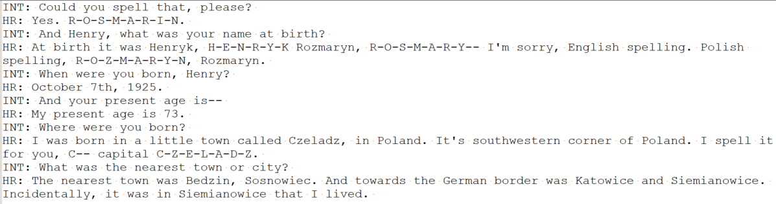
Classification Pipeline
Testimony

Slide 19
Classification Pipeline
Testimony
Responses

Slide 20
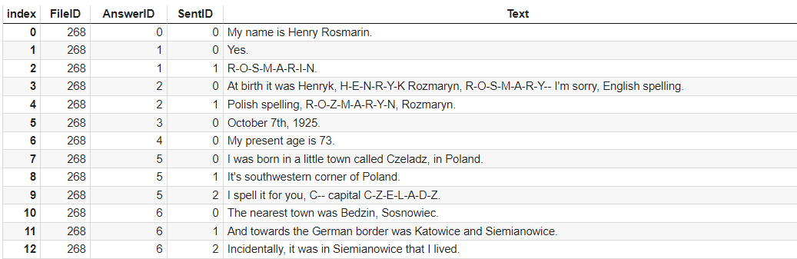
Classification Pipeline
Testimony
Responses
Sentences

Slide 21
Classification Pipeline
Testimony
Responses
Sentences
Emotions
And I used to be very afraid because I was the only Jew on the… on the street
Fear 😨
And at that time, I lost my mother and my sister and my little nephew
Sadness 😭
But still, they were incensed that this kind of jazz would be played there
Anger 🤬
So they were relieved to see us in the morning, coming back home
Joy 😀

Slide 22
Emotion Classifier
Base model is a fine-tuned checkpoint of the DistilRoBERTa-base model
Trained on 6 diverse datasets to predict Ekman's 6 basic emotions:
fear, anger, disgust, joy, sadness, surprise plus neutral
Our work focused on only four of the emotions;
fear, anger, sadness and joy
The outputs from the models are validated by LLMs: GPT 3.5, GPT4
The ‘voted’ emotion must be predicated by at least 2 out of the 3 models

Slide 23
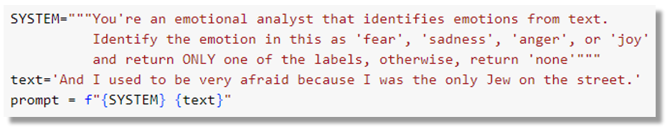
Prompting LLMs
Fear 😨
Result: ?

Slide 24
Classification examples
Sentence | fear | sad | anger | joy | roberta | gpt3.5 | gpt4 | voted
And I used to be very afraid because I was the only Jew on the on the street | 0.992 | 0.002 | 0.001 | 0.001 | fear | fear | fear | fear
And at that time, I lost my mother and my sister and my little nephew | 0.003 | 0.981 | 0.002 | 0.001 | sad | sad | sad | sad
But still, they were incensed that this kind of jazz would be played there | 0.002 | 0.003 | 0.971 | 0.001 | anger | anger | anger | anger
So they were relieved to see us in the morning, coming back home | 0.000 | 0.004 | 0.002 | 0.970 | joy | joy | joy | joy
They drove him out, out of the camp, and they said, go back | 0.067 | 0.023 | 0.353 | 0.007 | anger | fear | sad | none

Slide 25
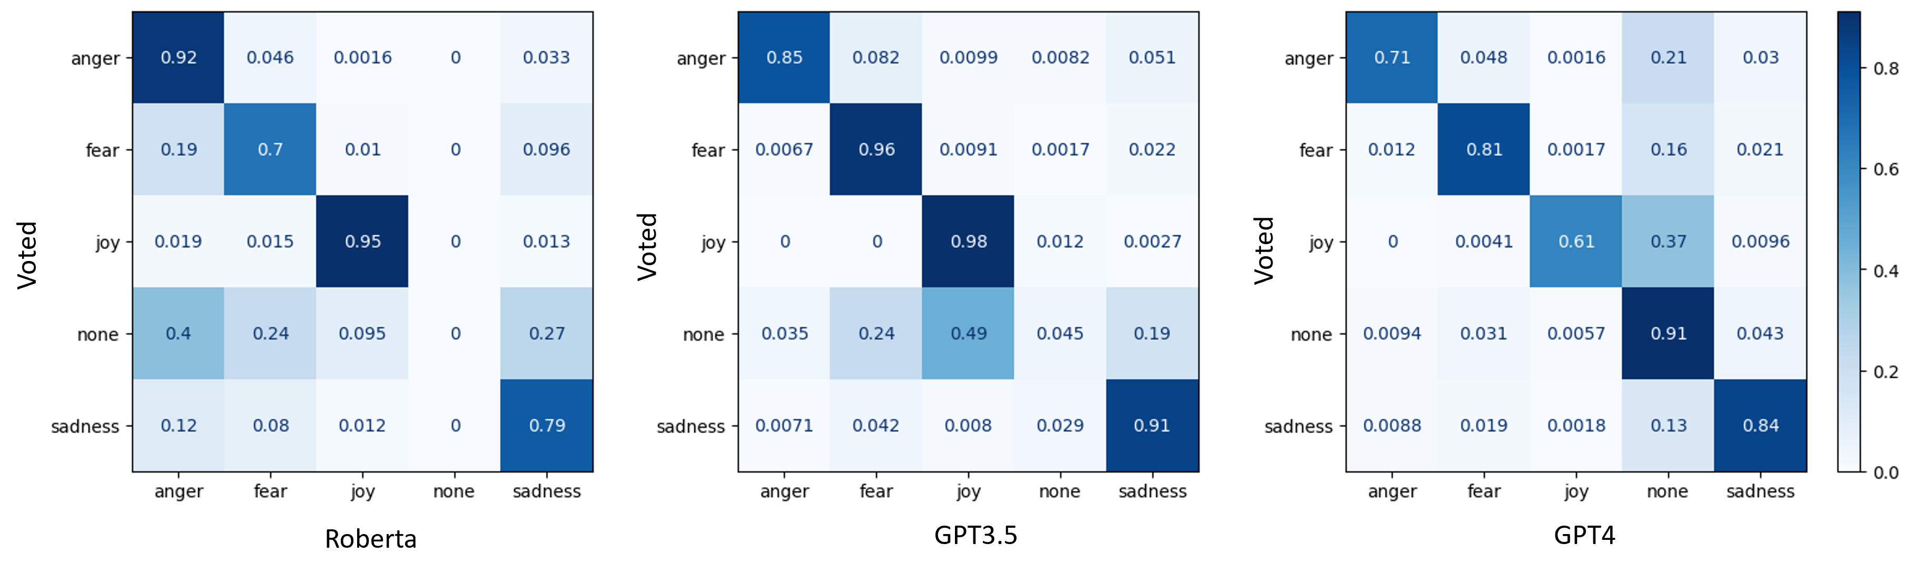
‘Voted’ vs other models

Slide 26
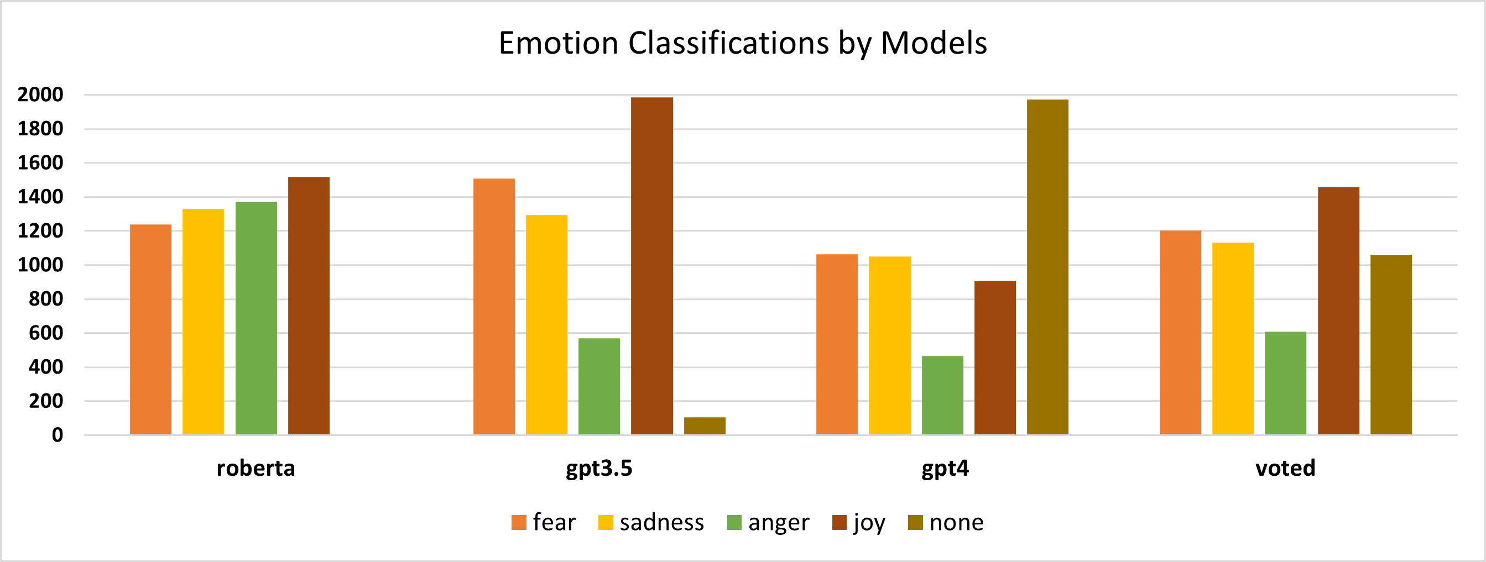
Emotion counts by models

Slide 27
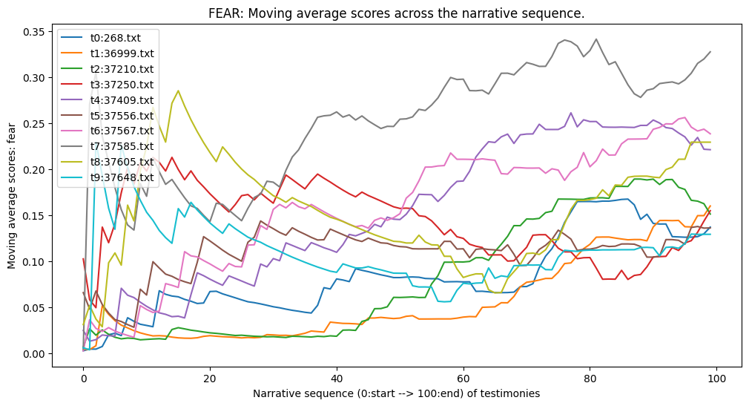
The journey of ‘fear’

Slide 28
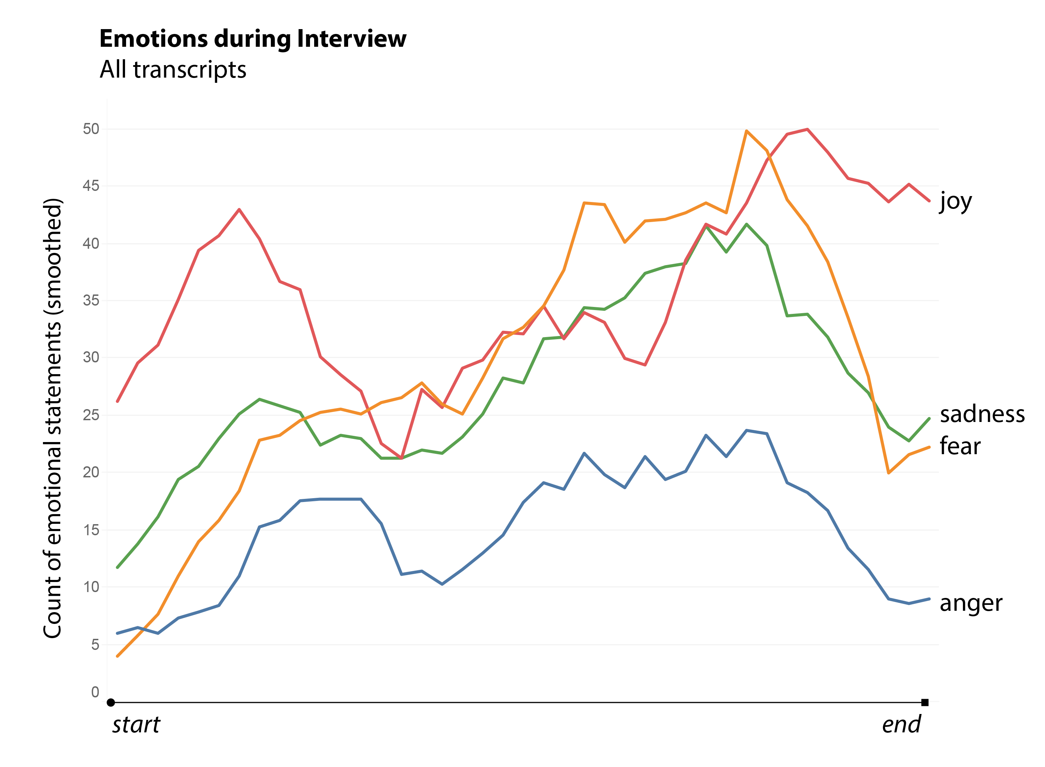
The journey of all emotion

Slide 29
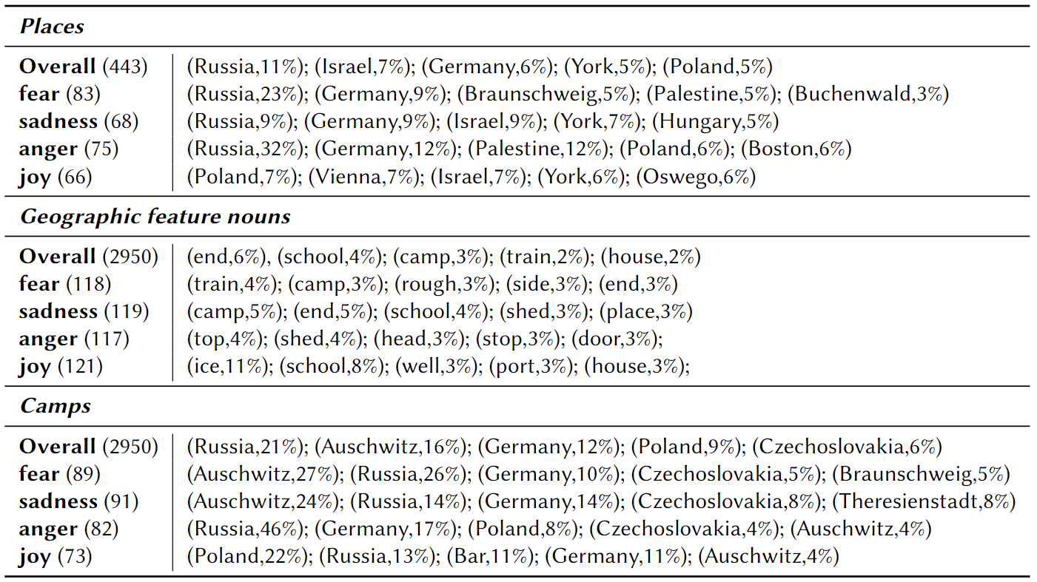
Also…emotions and places???
Notes:
Finally, Table \ref{tab:top_emotion_places} shows the connections we observe in these 10 texts between named places and the emotions observed. We split the results into three groups: 1) places, 2) geographic feature nouns, and 3) camps, and for each group, we list the overall top five in each group, plus the lists associated most with each of the four emotions. This serves to illustrate the potential of the technique for linking emotions to places of the different types under analysis.

Slide 30
Automatic Emotion Detection
Hard to accurately recognise human emotion, even harder to do it with text.
Various emotion classification schemes with different granularity.
Ekman’s scheme contains six categories (excluding neutral);
Plutchik’s scheme contains eight primary emotions;
GoEmotion Scheme contains twenty-seven emotions!
Emotion classification is partially subjective.
Does “surprised” imply happiness or shocking?
Different NLP tasks may need different emotion schemes.
How to select a scheme or design a new for a specific task?
LLMs may help to design new ones?

Slide 31
Related Issues
Can LLMs predict emotion?
Which categories? How accurately?
Can we modify Pre-trained LLMs for better performance?
Maybe, but how?
Does granularity of emotion scheme affect the LLM performance?
Maybe, let’s find out.
Which LLMs perform better for emotion identification?
we don’t know exactly, let’s compare them.
In this tutorial,
we’ll travel through these issues, and hopefully you can find the answers!

